Slide 1
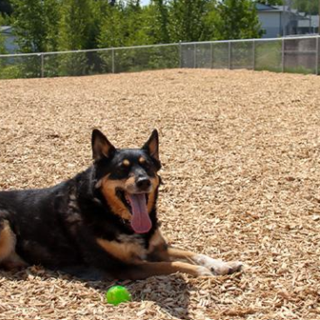
Parks and Recreation Commission
Trial Dog Park
September 16, 2025

Slide 2
Background
  Commission established potential development of downtown dog park in FY20/21 work plan
  Commission worked to identify former Community Garden site
  Future fire station footprint unknown at the time; Council asked to postpone until the station was developed
  New Butterfield Fire Station is now open

Slide 3
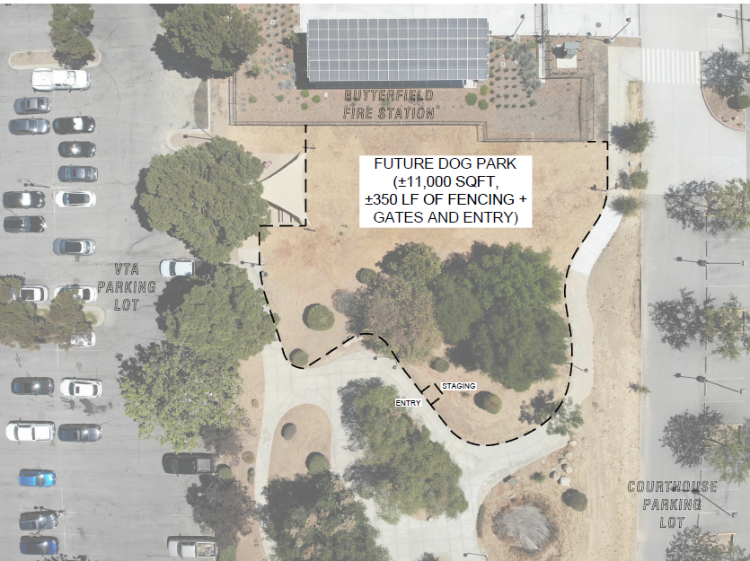
Map

Slide 4
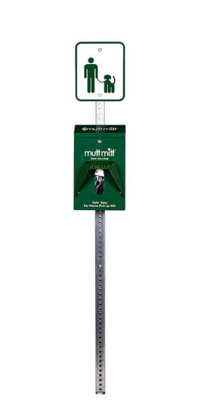
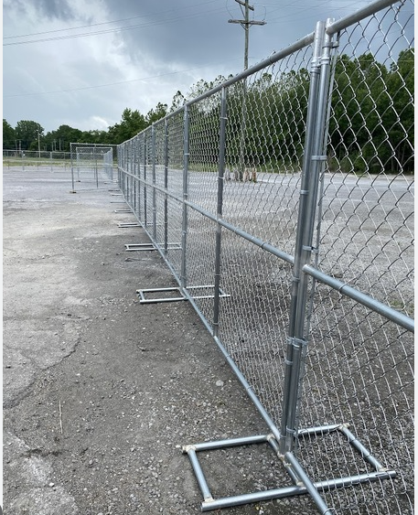
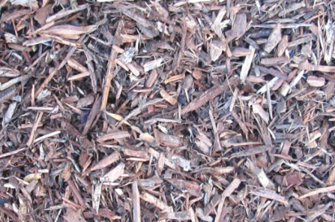
Amenities
  Basic to start
  Temporary fence with double gate entry
  Trash can and mutt mitt dispenser
  Mulch as ground cover

Slide 5
Outreach
  Fire Station and Courthouse outreach
  Signs at trial location as well as current dog park
  Information on website
  The Scoop, Nextdoor, social media and downtown

Slide 6
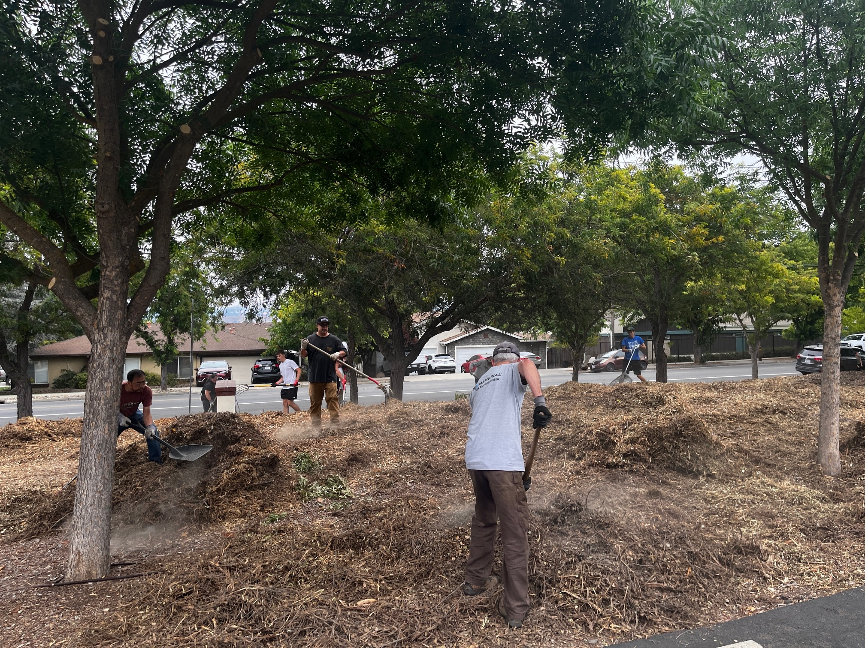
Volunteers
  Mulch spreading day on September 27
  Monitor cleanliness of dog park and help clean up as needed
  Engage with users to gather feedback

Slide 7
Timeline
  September/October – Maintenance team planning and outreach
  September 27 – Volunteer work day to spread mulch
  October 8 – Dog park officially opens
  3 month trial period*
  January 20, 2026 – PRC evaluation of trial dog park and determine next steps
  *Dog park subject to closure based on weather

Slide 8
Questions?

