Slide 1

Dave’s Redistricting App Quick Start Guide
For local government redistricting
Prepared by National Demographics Corporation (NDC)
October 24, 2021

Slide 2

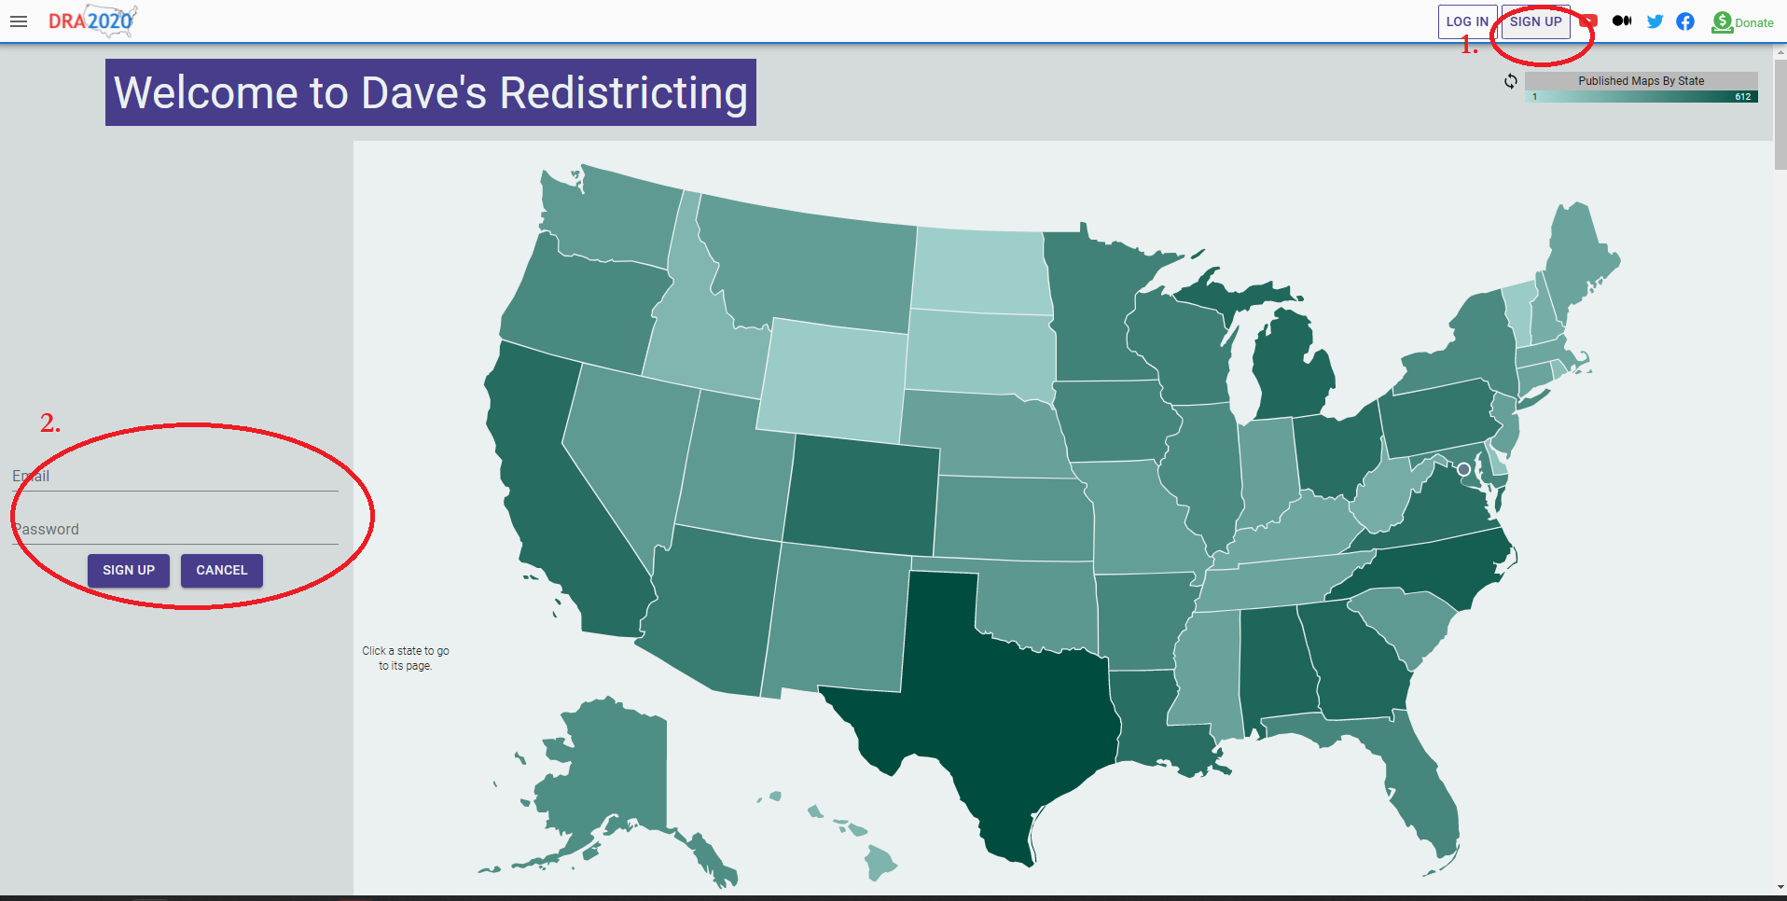
https://davesredistricting.org
When you start with Dave’s Redistricting App, you’ll need to create an account:
Click on “Sign Up” in the upper right hand corner
Fill out your email and create a password

Slide 3
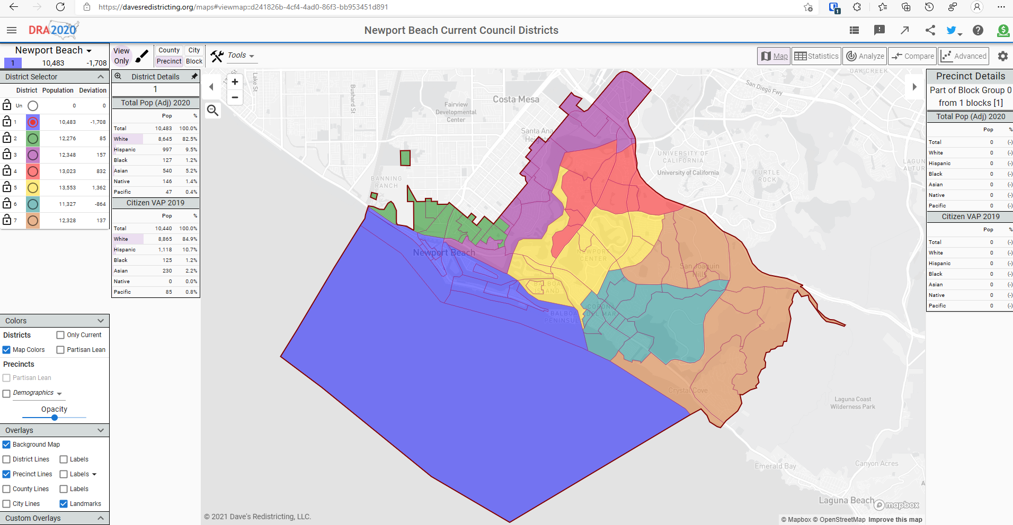
https://davesredistricting.org
To get started after you log in, click link on the city’s website to view either the current districts or a blank map.
You start in “View Only” mode. To create an editable version, click the paintbrush next to the View Only button

Slide 4
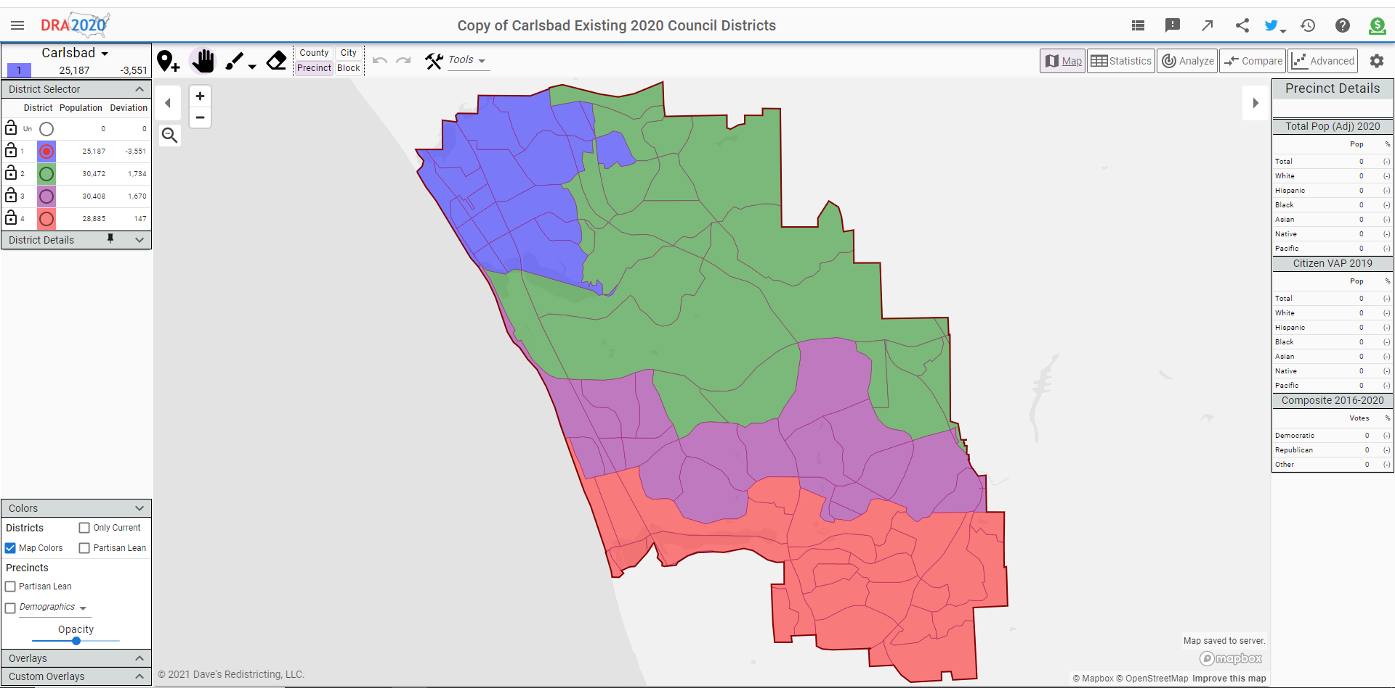
https://davesredistricting.org
Click on the plan title to change the name and to enter a description of your plan (see the next slide).

Slide 5
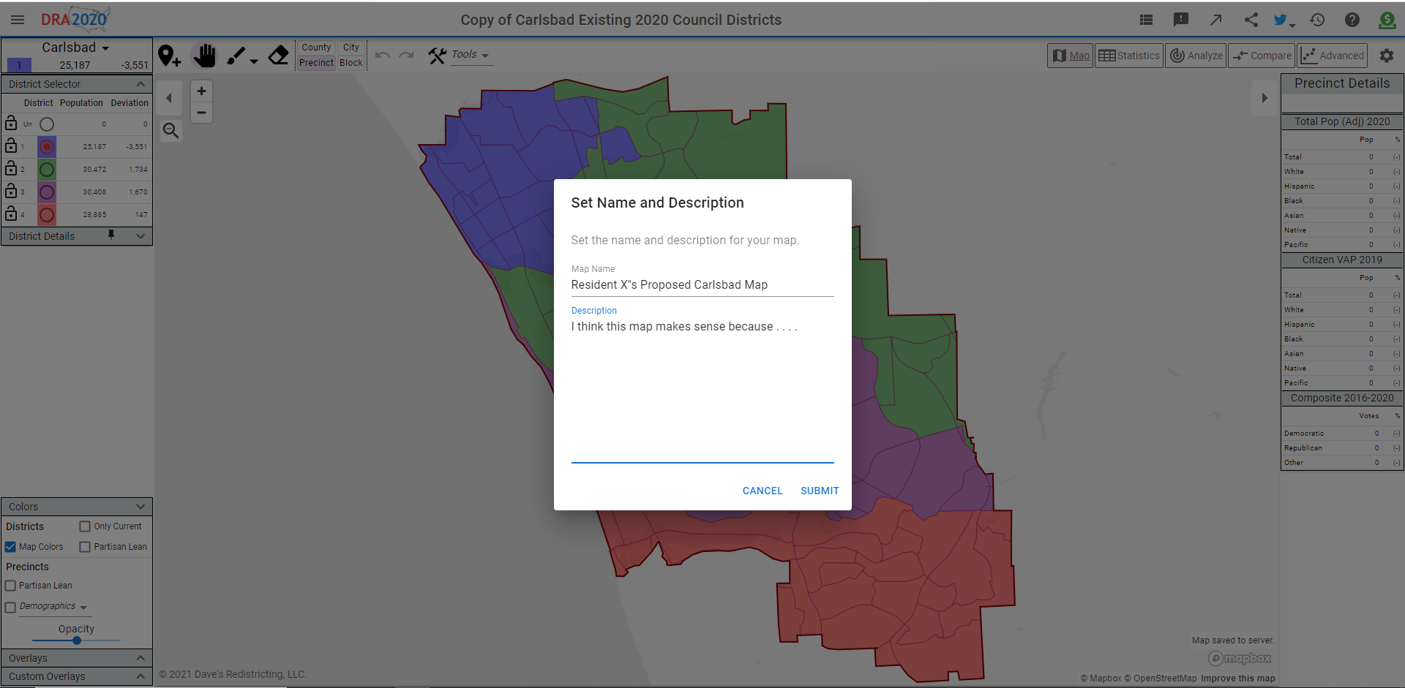
https://davesredistricting.org

Slide 6
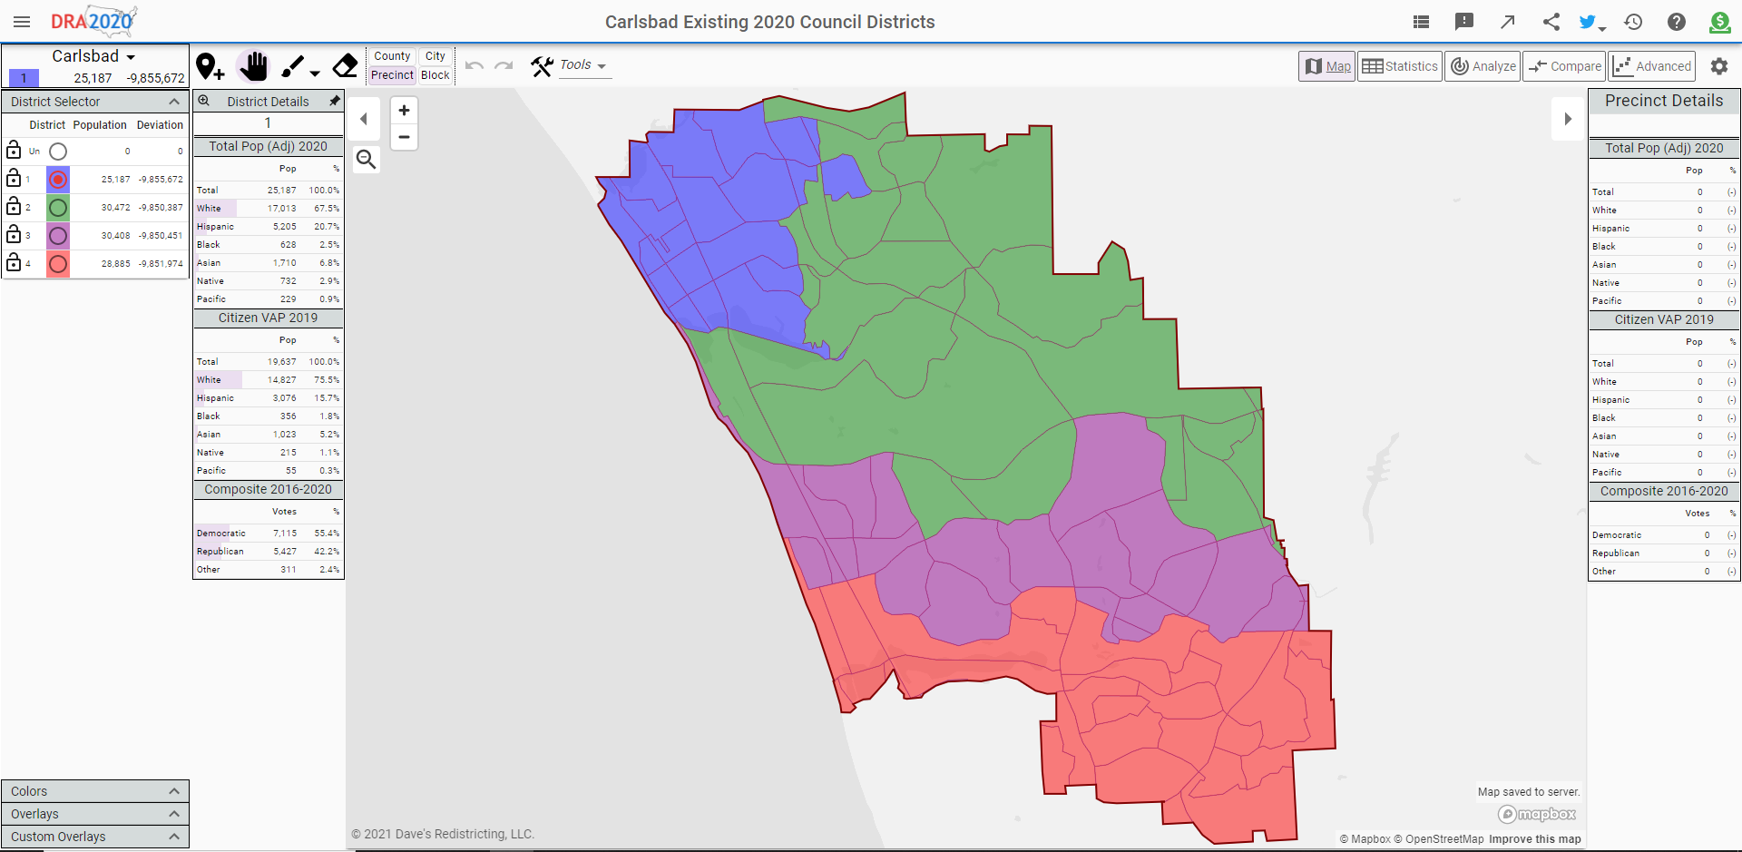
https://davesredistricting.org
The “overlays” option will add streets and labels to the map

Slide 7
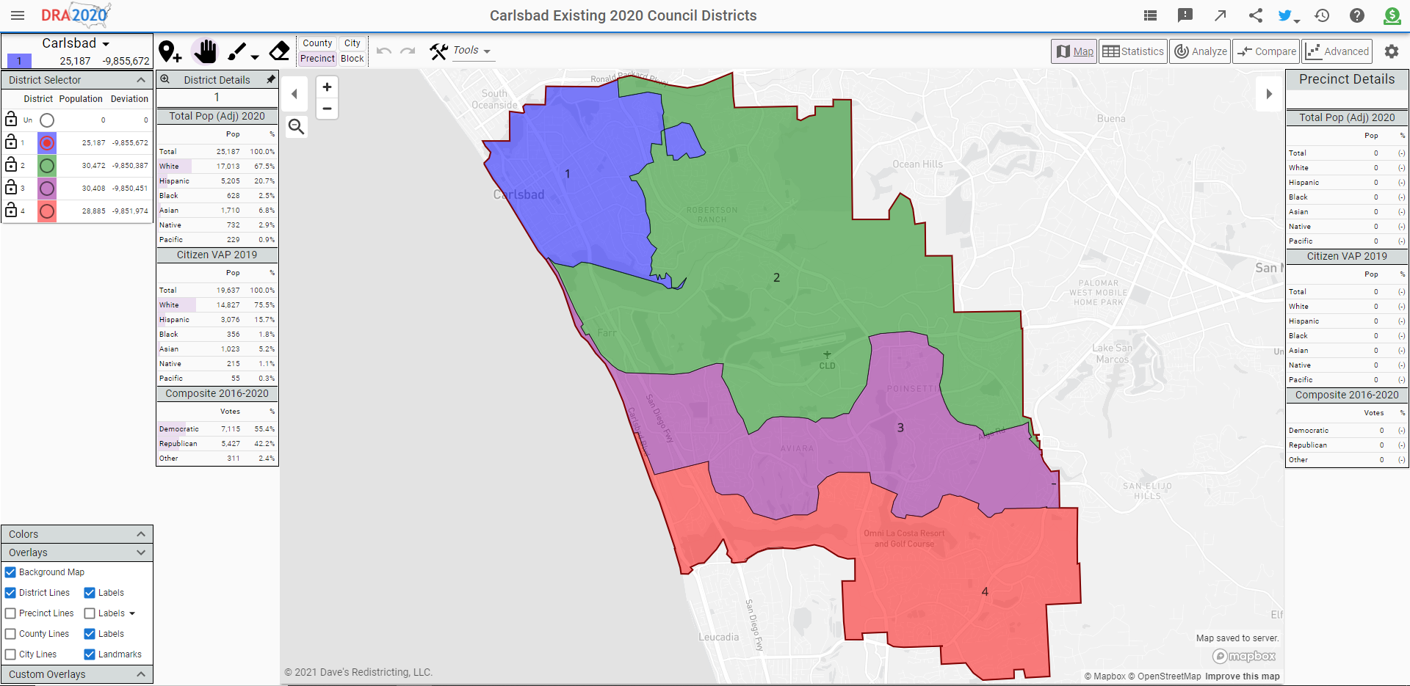
https://davesredistricting.org
“Background Map” is required to see streets and other features.
NDC recommends you select Background Map, District Lines (where available), the two Labels options, and Landmarks.
If you want population numbers on the precincts and census blocks, also click the “Labels” option with the down arrow next to it and see the instructions in the next screen.

Slide 8
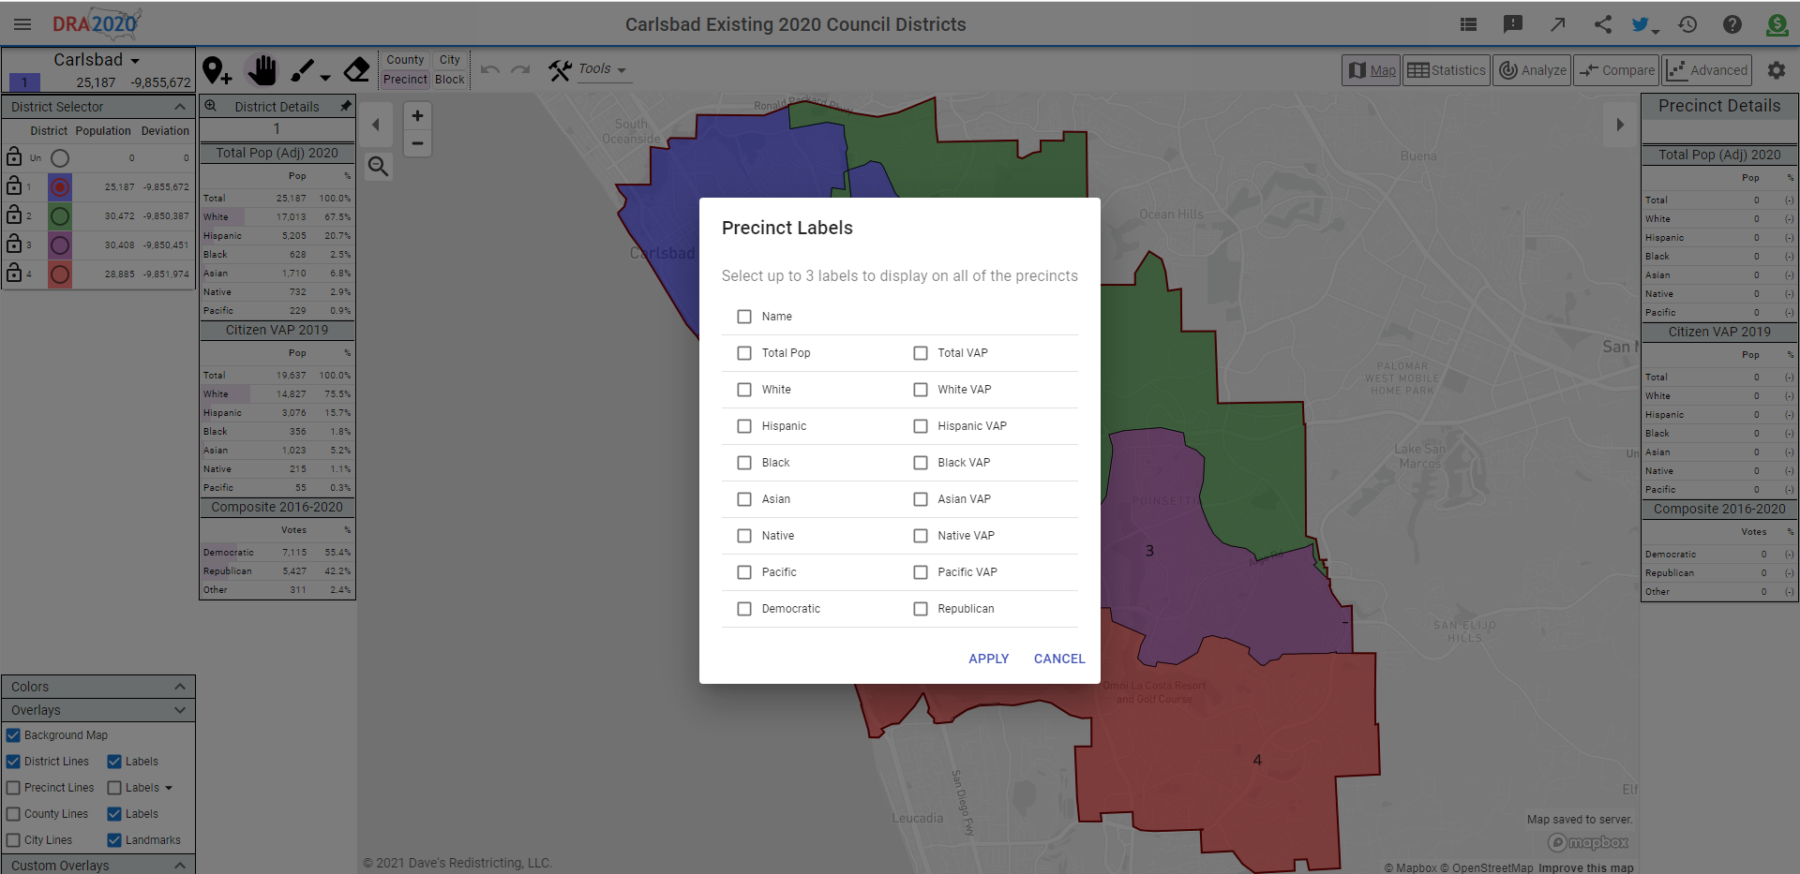
https://davesredistricting.org
Choose which labels you want to see on the geographic units in the map. NDC recommends including at least “Total Pop.”
If you “shatter” a precinct to view the individual census blocks in it, the same labels will appear on the individual Census Blocks.
With your overlays selected and label assigned, now you are ready to draw your map (see the next set of instructions).

Slide 9

NDC’s guide to Dave’s Redistricting App main screen
Use the “hand” to move the screen around, the “paint brush” to select precincts or blocks, and the “eraser” to undo any assignments.
Click on the plan title to change the name and to enter a description of your plan (see the previous slide).
Zoom in and out using the + and – buttons.
As you draw your map, details of the precinct or census block you click on will appear here. (To see the data for the district you are currently drawing, see the “District Details” option on the left side of the screen.)
Click on the appropriate circle to choose which district to assign the next precinct or block you click.
Click “District Details” to see running totals for the district as you create it (see the next slide).

Slide 10
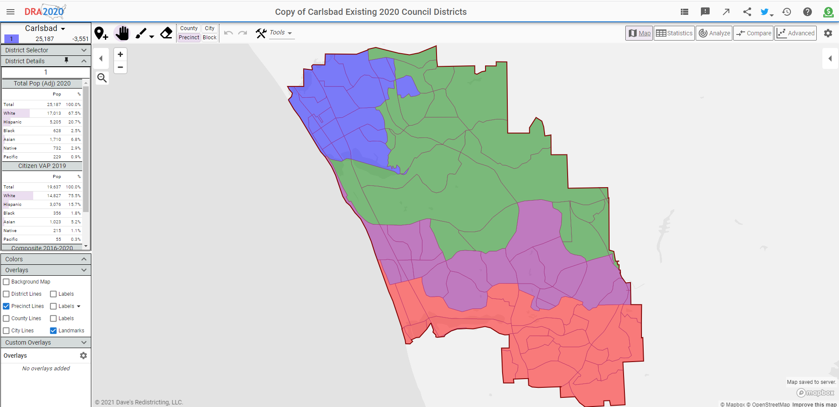
https://davesredistricting.org
Click “District Details” to see running totals district you are currently drawing (district number is given at the top).

Slide 11
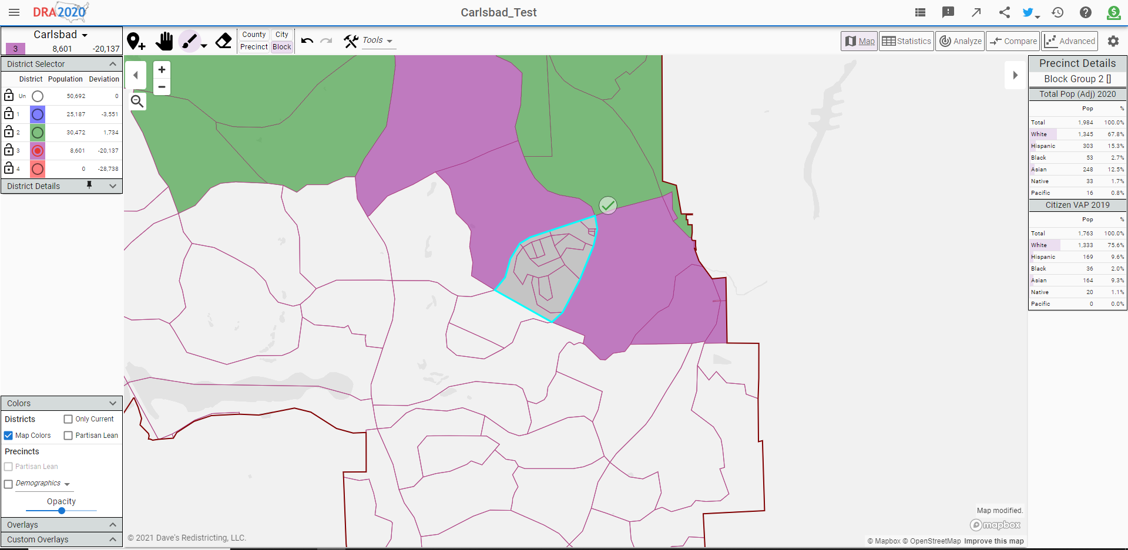
https://davesredistricting.org
If you set the selection level to “Block,” when you click on a precinct the precinct will “shatter” and the blocks that make up that precinct will appear.

Slide 12

https://davesredistricting.org
When you are finished, click on the “Maps” button.

Slide 13
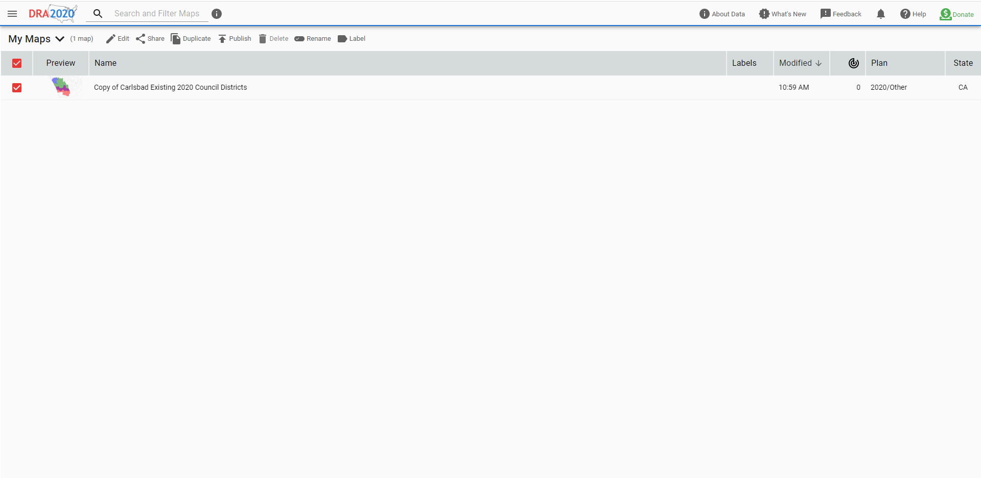
https://davesredistricting.org
First, click on the check box or the plan name of the plan you are ready to publish.
Then click the “Publish” button (there is one more step – see the next slide).

Slide 14
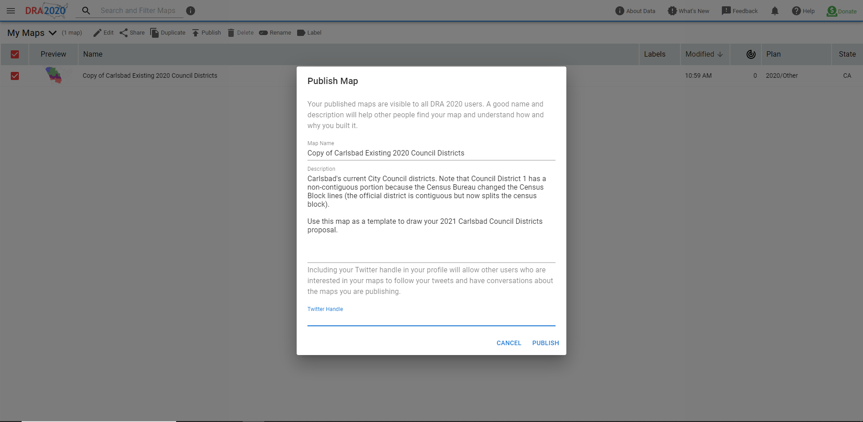
https://davesredistricting.org
Here is your last chance to change the plan name and/or description before it goes public.
And, if you wish, add your Twitter handle to be alerted if others discuss your plan in Twitter.
Then click “Publish.”
Very Important:
You must then send an email to the jurisdiction with the plan name you just published (otherwise they jurisdiction will not know you have drawn it and will be unable to include it in their deliberations).

Slide 15
There is much more information and more detailed how-to guides available at www.davesredistricting.org

