Slide 1
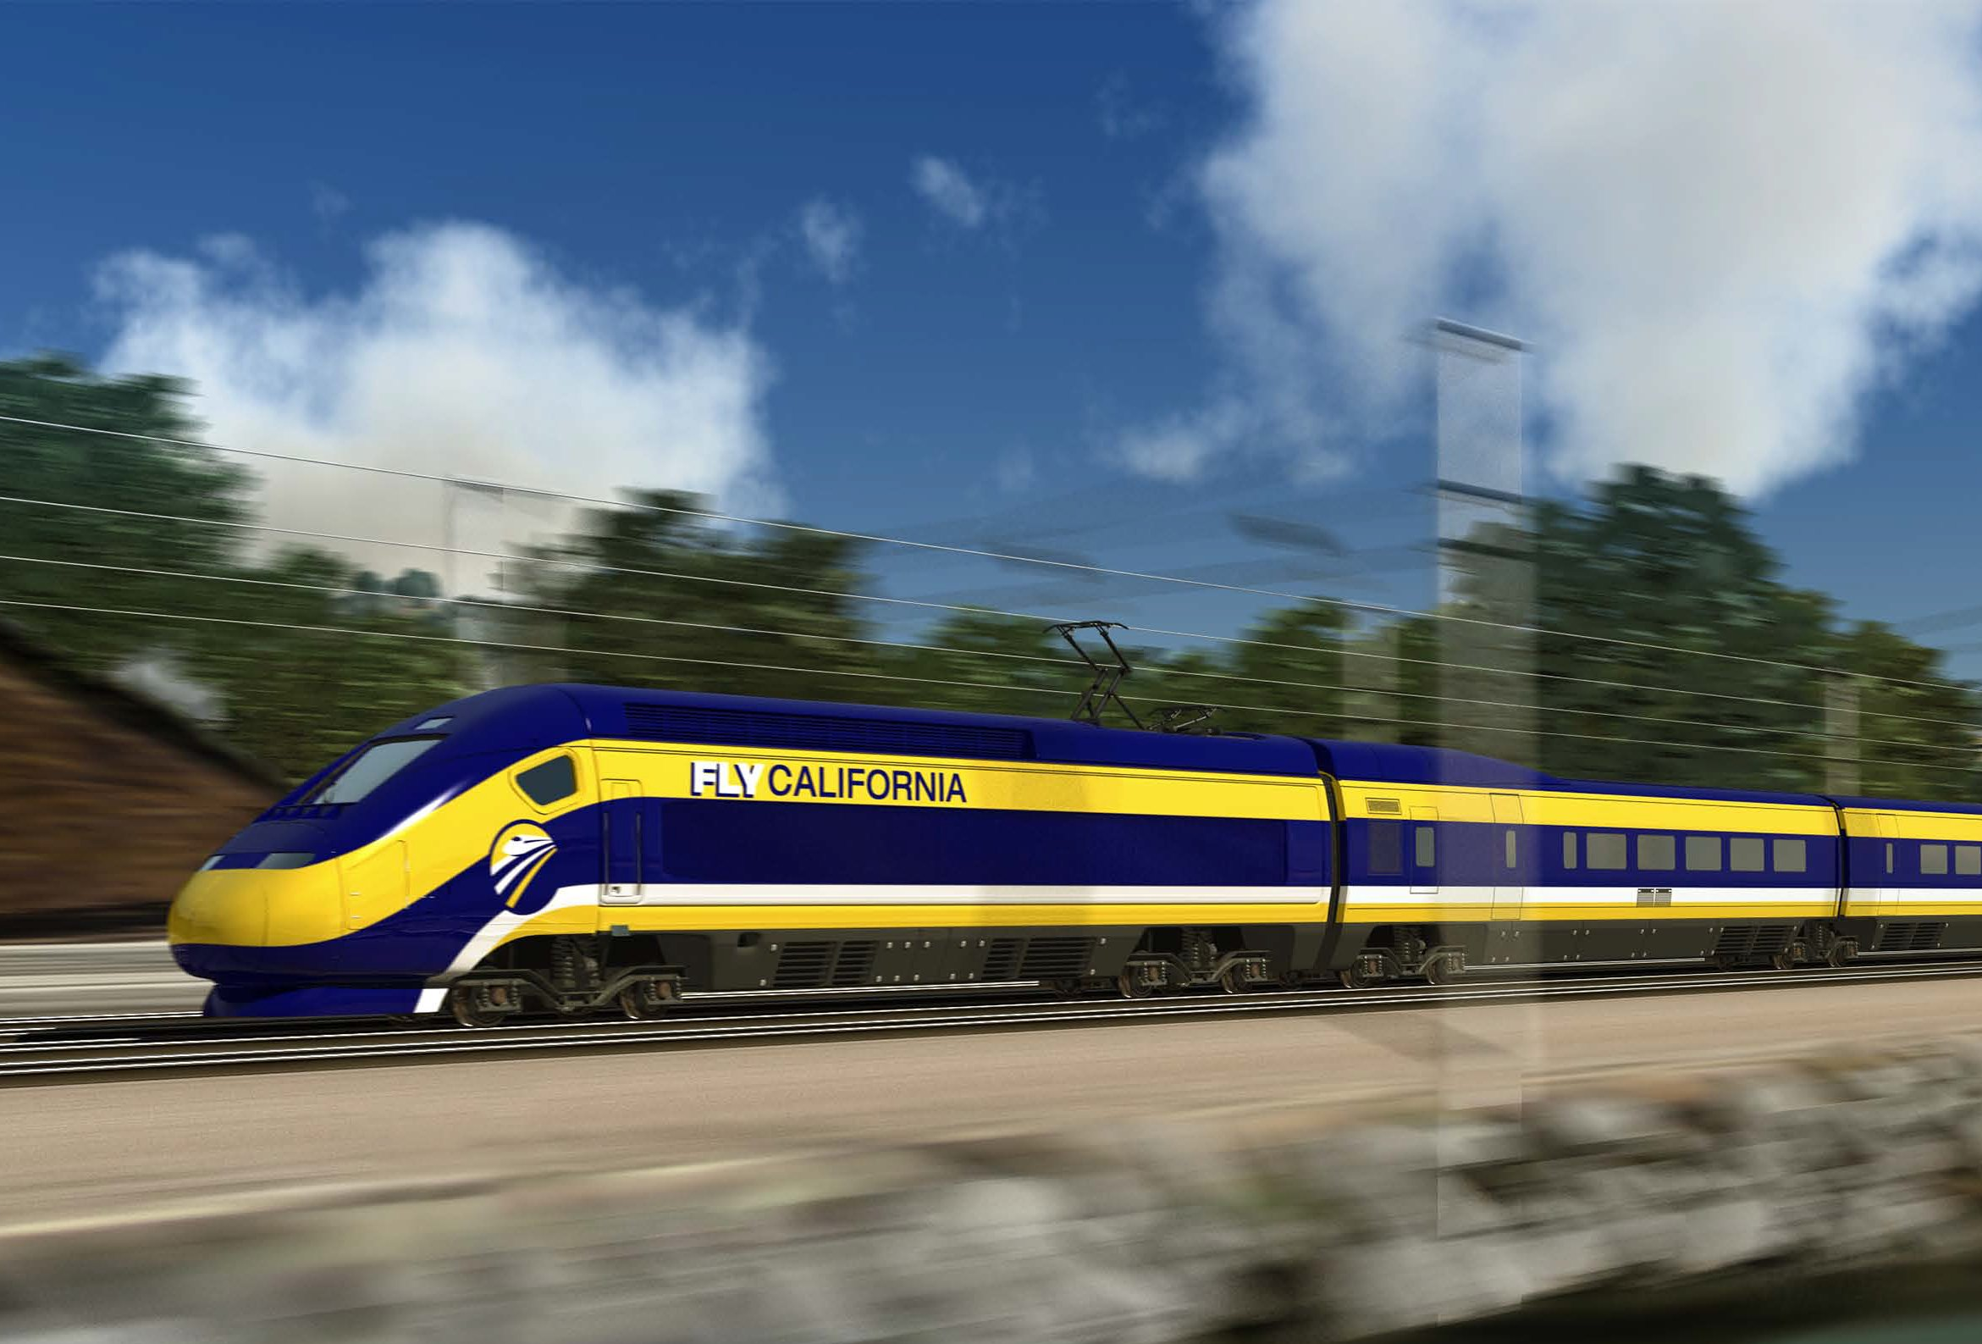
Morgan Hill City Council
High Speed Rail Workshop
November 15, 2017
Notes:
Good Evening Mr. Mayor and City Council
My team has been analyzing the alignments proposed by the CHSRA and has explored additional alignments as possible alternatives.
Over the next several minutes I will be outlining the work performed, comments by the CHSRA on the Morgan Hill proposed alternatives, and conclusions reached as part of the study.
The presentation will start with an overview of what the CHSRA is currently studying in the vicinity of Morgan Hill. I will go over the attributes and some of the impacts associated with those alternatives
After that, I will be going over the three alignments studied as a potential alternatives to what the CHSRA has proposed. I will go over the pros and cons of each alternative.
Finally, I will provide conclusions from the study.

Slide 2
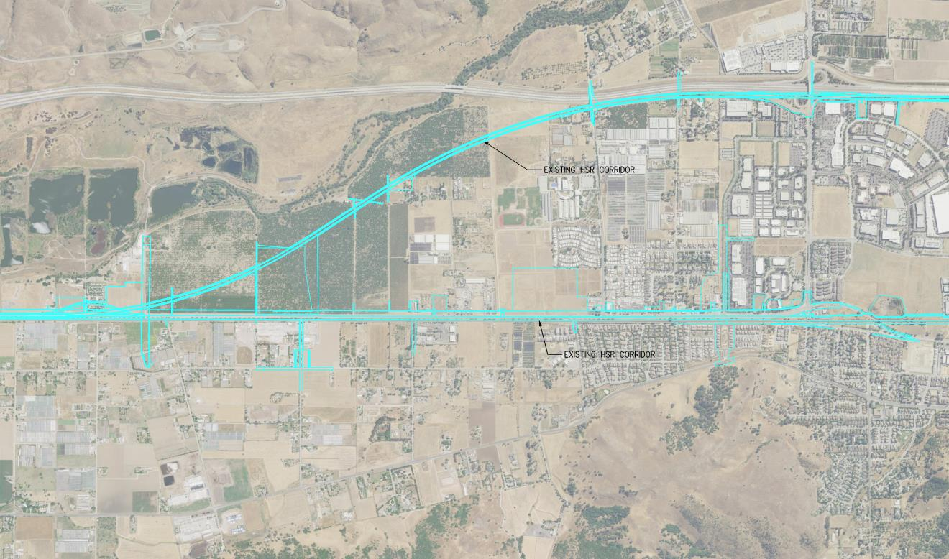
CHSRA Proposed Alternatives

Slide 3
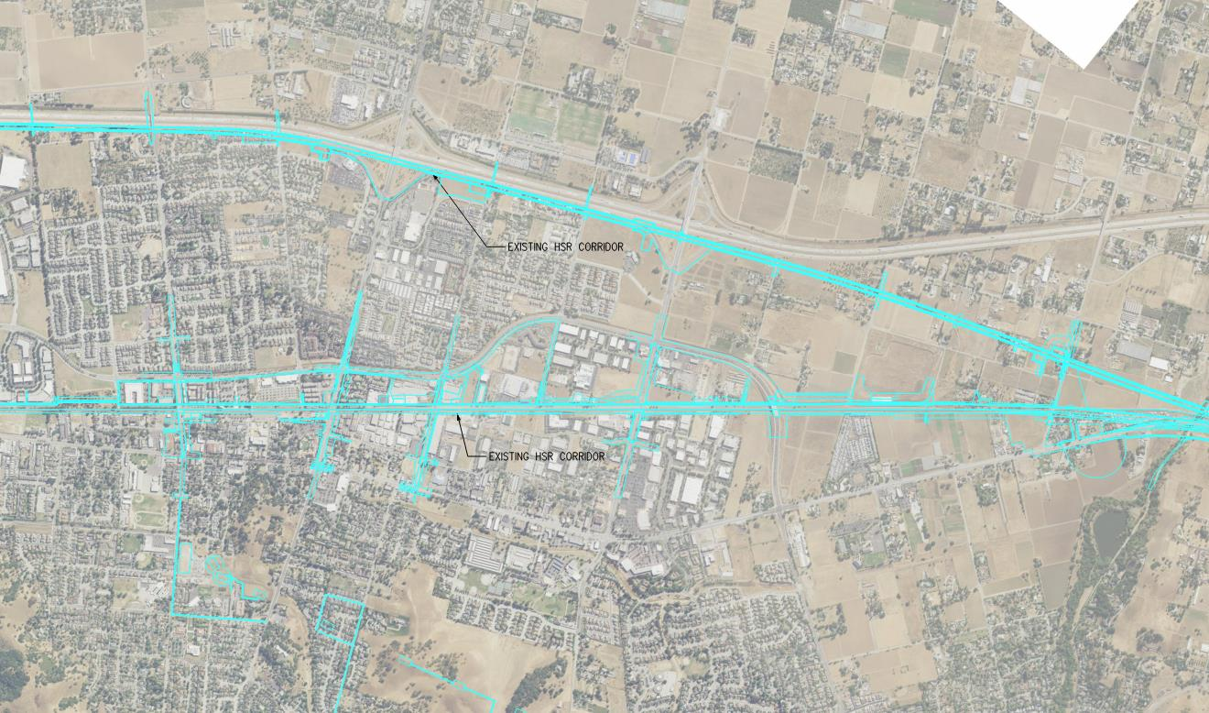
CHSRA Proposed Alternatives

Slide 4
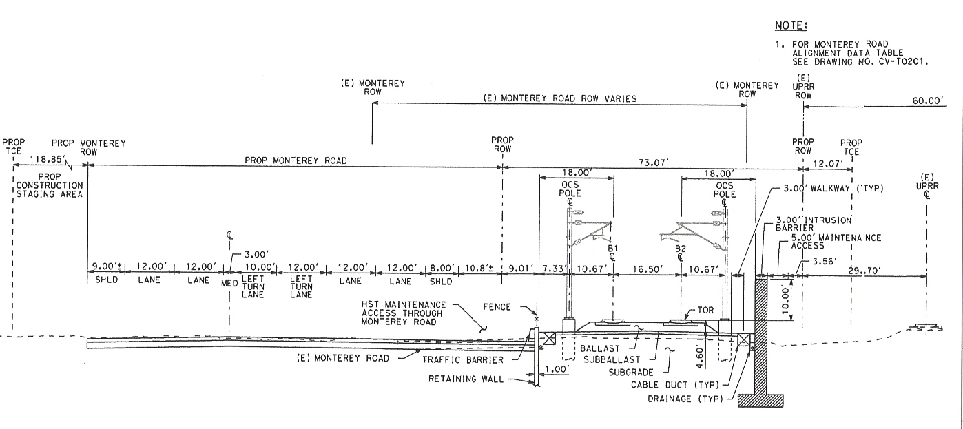
Embankment along uprr
Notes:
The CHSRA proposed viaduct would be 50-60 feet high along the west side of US-101.
The alignment is elevated to pass over the existing interchanges with US-101.
This alternative impacts residences along the highway. In addition, the height of the structure creates significant visual impacts in the neighborhoods. In addition the alignment will create noise and vibration impacts that will be mitigated as part of the environmental work.
In addition, the construction of the viaduct will create significant impacts.

Slide 5
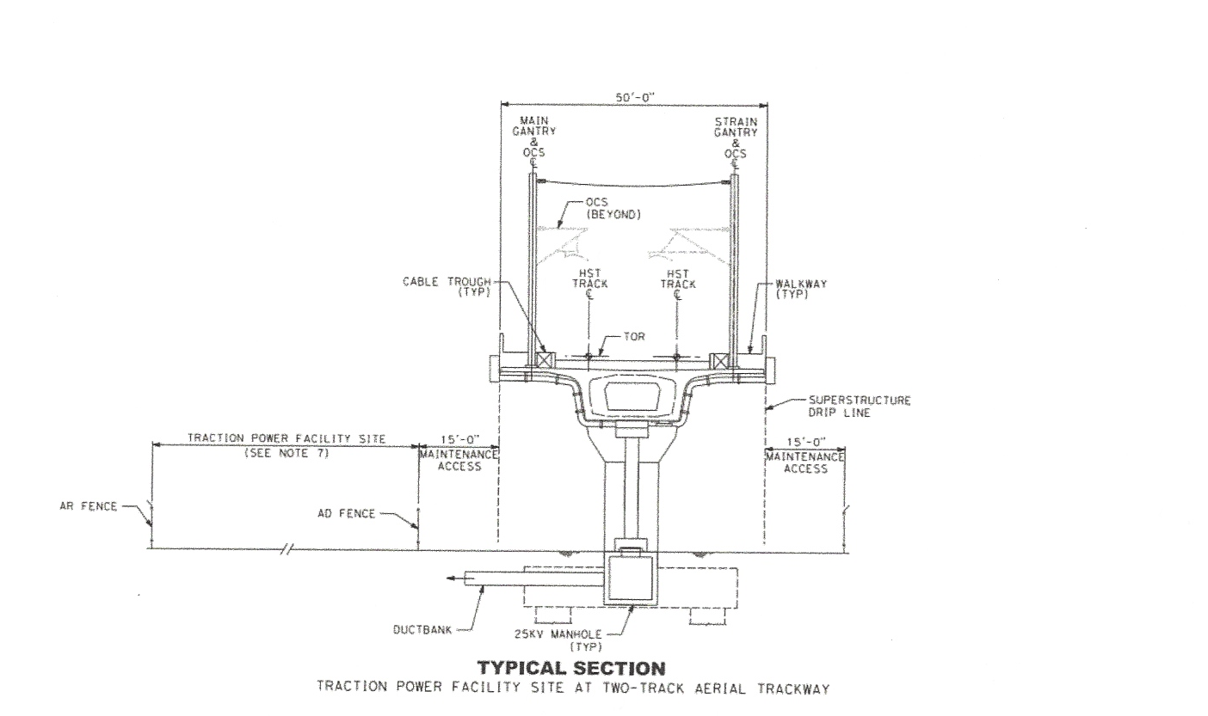
Viaduct along Hwy 101

Slide 6
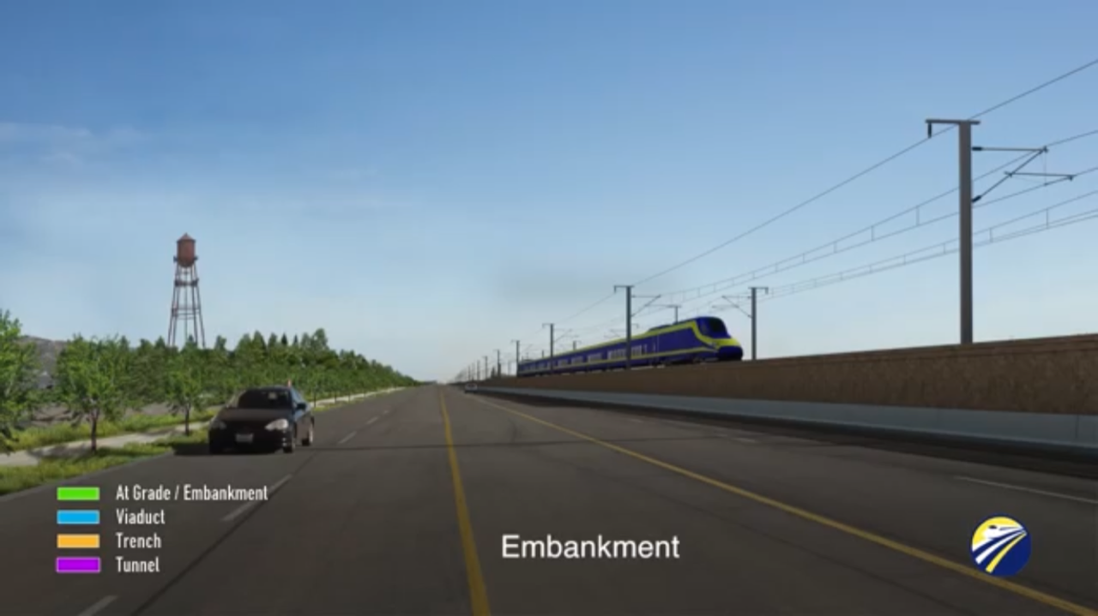
Notes:
The CHSRA proposed viaduct would be 50-60 feet high along the west side of US-101.
The alignment is elevated to pass over the existing interchanges with US-101.
This alternative impacts residences along the highway. In addition, the height of the structure creates significant visual impacts in the neighborhoods. In addition the alignment will create noise and vibration impacts that will be mitigated as part of the environmental work.
In addition, the construction of the viaduct will create significant impacts.

Slide 8
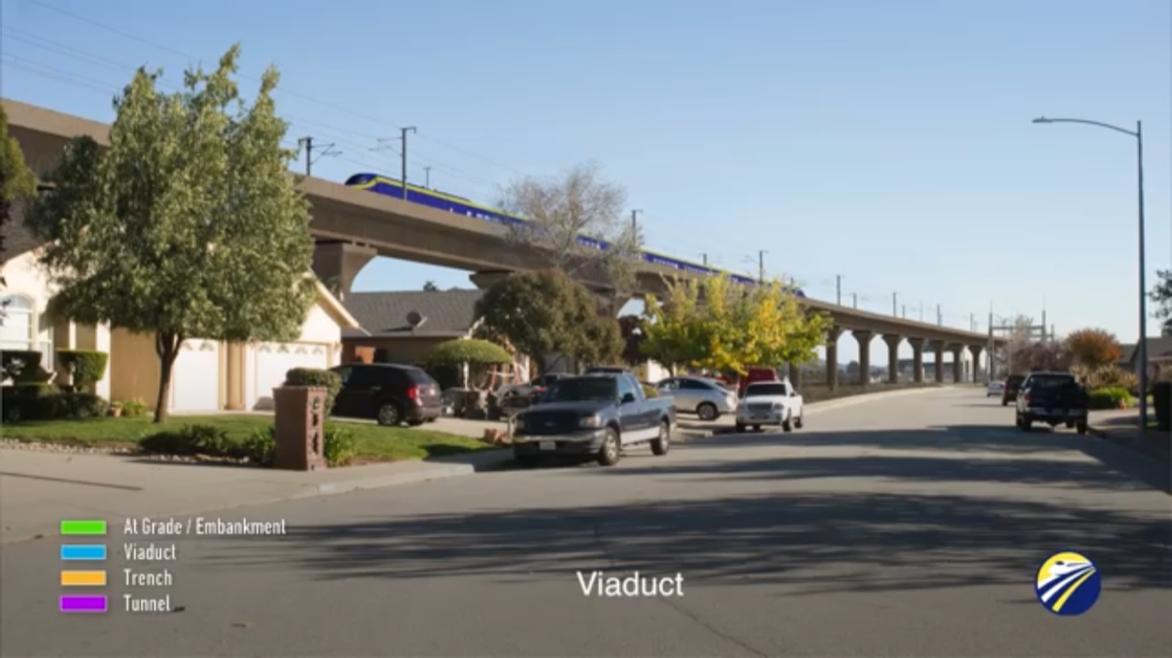
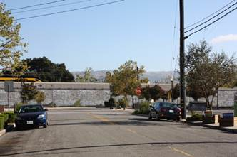

Slide 9
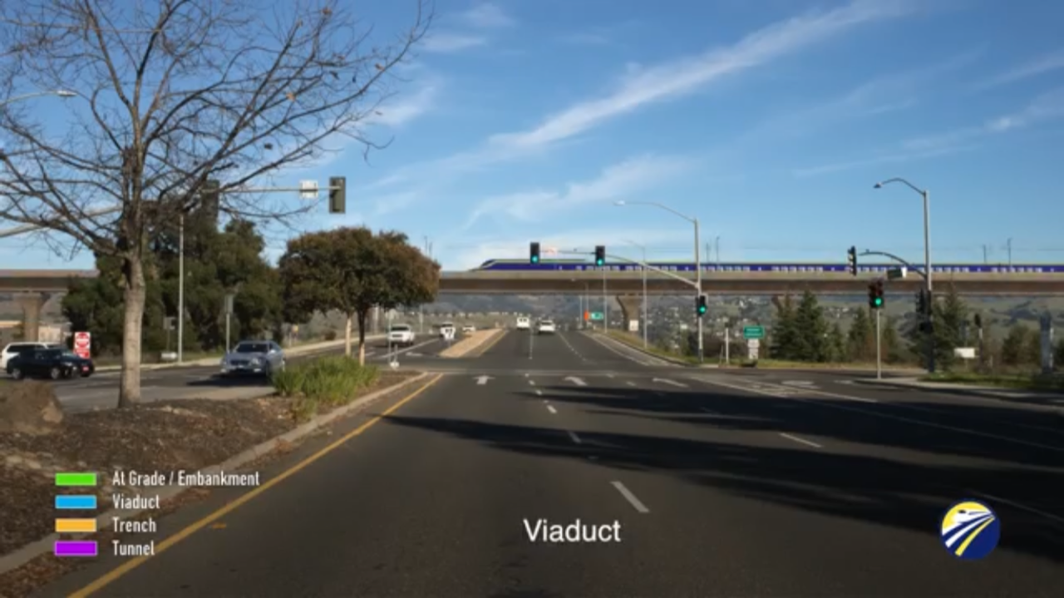

Slide 10
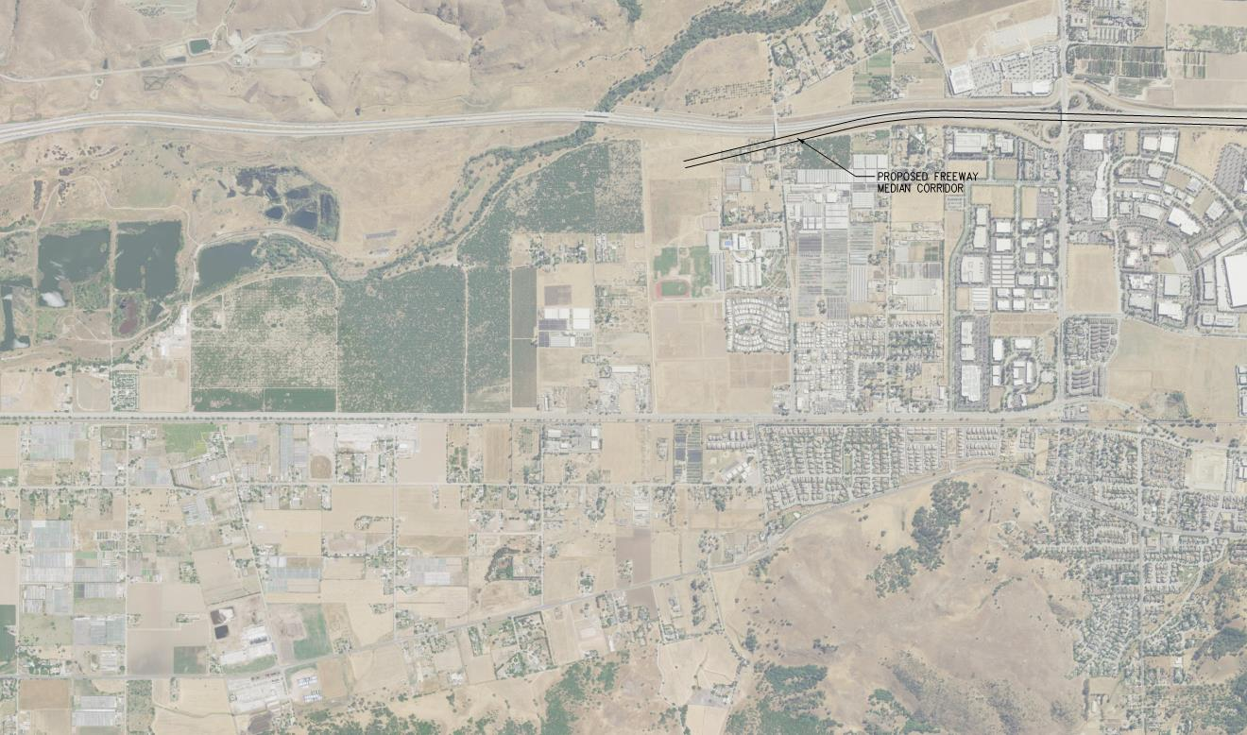
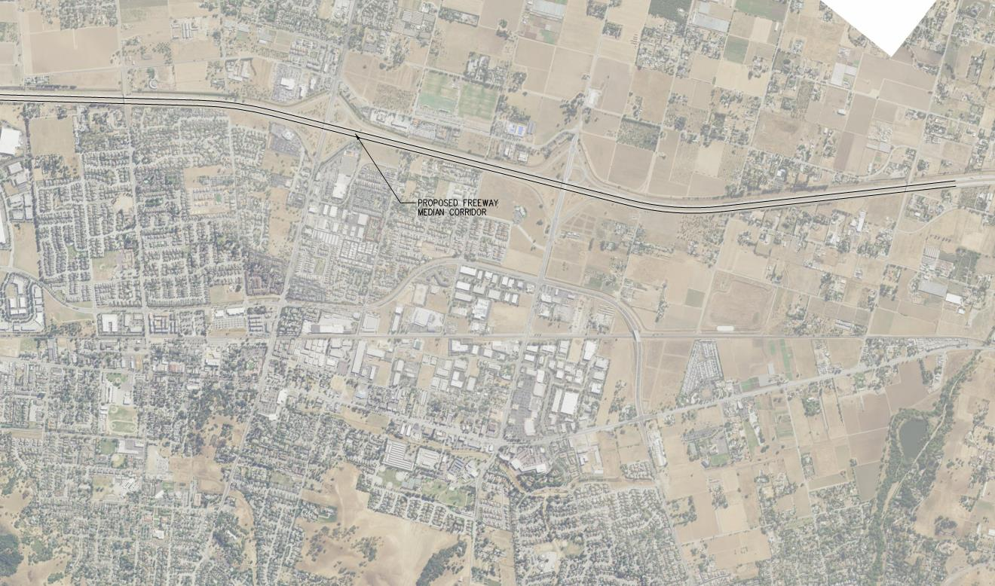
US-101 Median Alternative

Slide 11
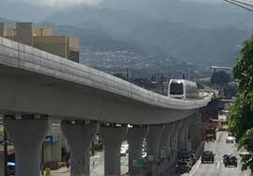
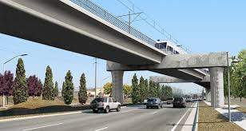
HWS US-101
Design aspects
Located within the median at Morgan Hill.
Design speed is 90-100 mph.
Connects with CHSRA alignments north and south of Morgan Hill.
CHALLENGES
Cannot continue in the median south of the City due to San Martin Airport.
Reduced speed, 100 mph, due to freeway curves.
Complex structures where it enters and exits the freeway right-of-way.
Not compatible with approved High Occupancy Toll (HOT) lanes project by Caltrans for the current US-101median.
Notes:
The first of the Morgan Hill studied alternatives is a viaduct down the median of US-101. The top photo shows what such a structure would look like although the CHSRA structure would have higher sound walls on top of the structure than shown in the photo.
The alignment cannot be located within the median south of Morgan Hill since it would impact the Runway Protection Zone for San Martin Airport.
The design speed that can be achieved with this alternative is only 100 mph. This is a significant issue. The high-speed rail is statutorily required to travel between Los Angeles and San Francisco in 2 hours and 40 minutes. The reduced speed due to this alignment is an issue with the CHSRA since it will significantly impact these travel times.
The alternative carries with it complex structures, such as straddle bents, at it enters and exits the US-101 median. The bottom photo shows a straddle bent structure.
Caltrans has prepared a Project Study Report on the US-101 Expresslane Project. This alignment is not compatible with a variant of this proposed project.

Slide 12
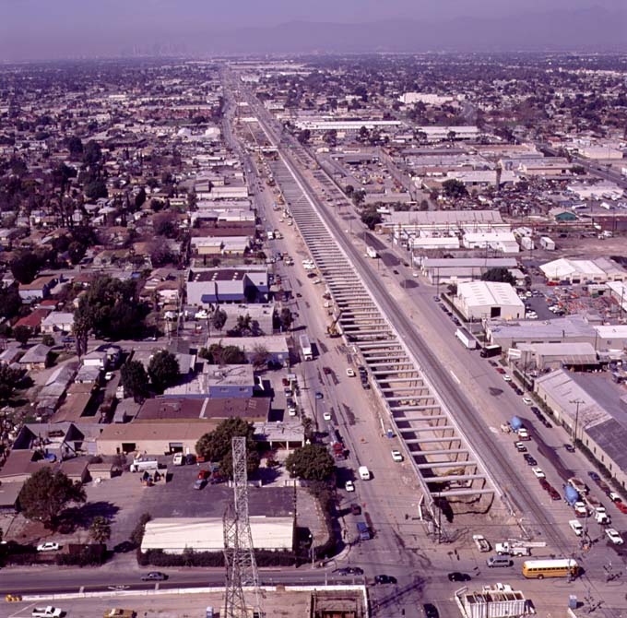
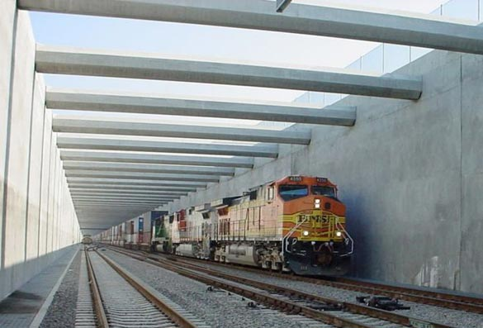
Trench on west side of US-101
Notes:
A second alternative studied by the City is a trench located in the same footprint of the CHSRA proposed viaduct along the west side of US-101.
With traditional trench structure, such as that used in the Alameda Corridor project, this alternative offers reduced costs as well as construction impacts.
In addition, the trench option significantly reduces visual impacts and is more accessible.
The photos shown are of the Alameda Corridor trench. This trench is 10 miles lone built in the urban environment of Los Angeles.

Slide 13
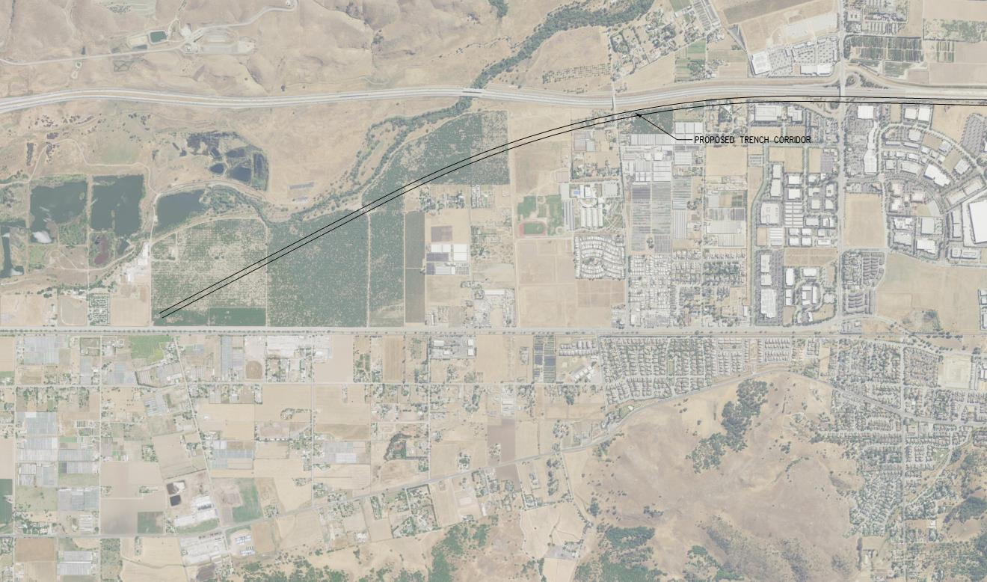
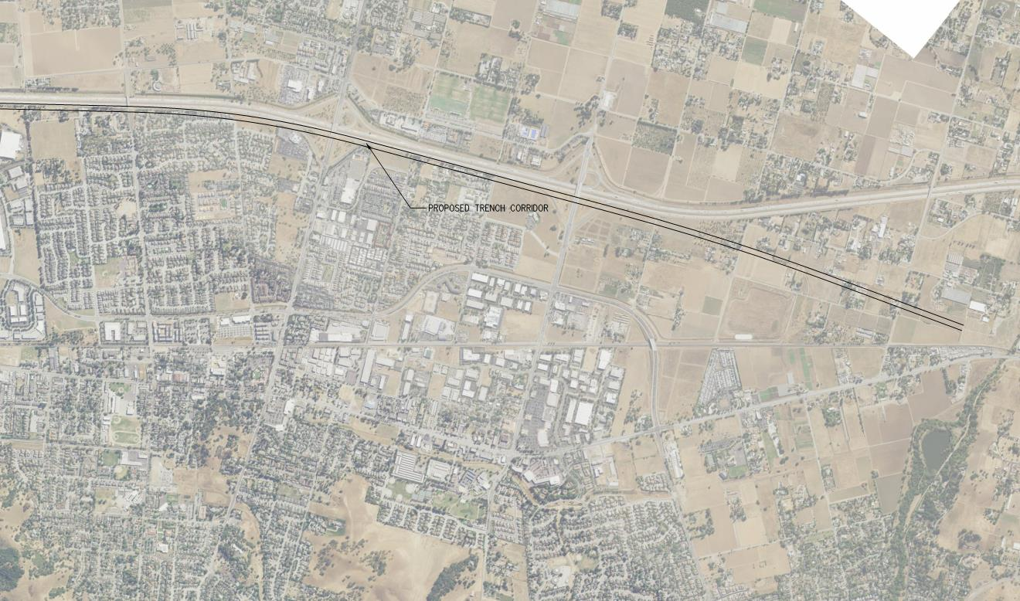
Trench Alternative

Slide 14
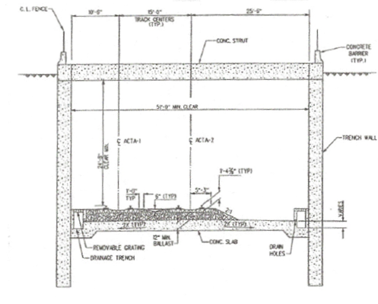
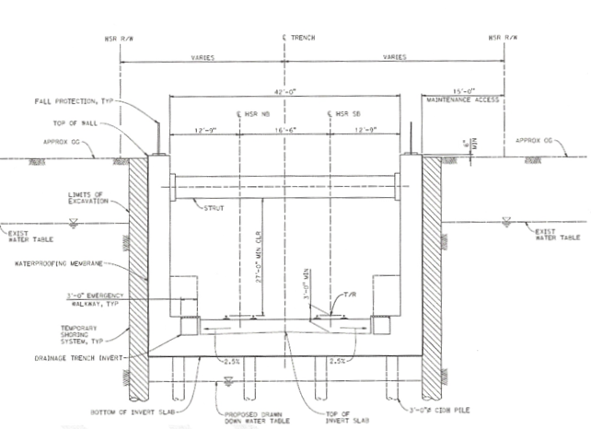
CHSRA required trench
Traditional trench Design Requirements
Cast in drilled hole walls
Minimal construction footprint
Reduced operating footprint
CHSRA Design Requirements
Must be fully waterproof
High water table creates additional design elements
Larger construction footprint
No secant piles creating additional structural considerations
Significant construction costs
Notes:
However, the CHSRA has provided a draft memo that states the trench alternative is not appropriate for this application.
The top diagram is a traditional trench structure used in the Alameda Corridor and other locations.
This structure uses cast in drilled holes construction with secant piles. Struts are used along the top of the trench for seismic stability.
This type of structure allows construction with minimal outside impacts by constructing within the footprint. Also, this structure is relatively inexpensive at roughly $80M per mile.
The bottom diagram is what the CHSRA is requiring for a trench. They require the trench to be completely waterproof therefore secant pile construction is not preferred. There trench creates a larger construction footprint due to over excavation and shoring. In addition, the high water table at Morgan Hill will require additional cast in drilled hole piles to reduce uplift of the structure. The construction cost associated with this structure is approximately $320M per mile.

Slide 15
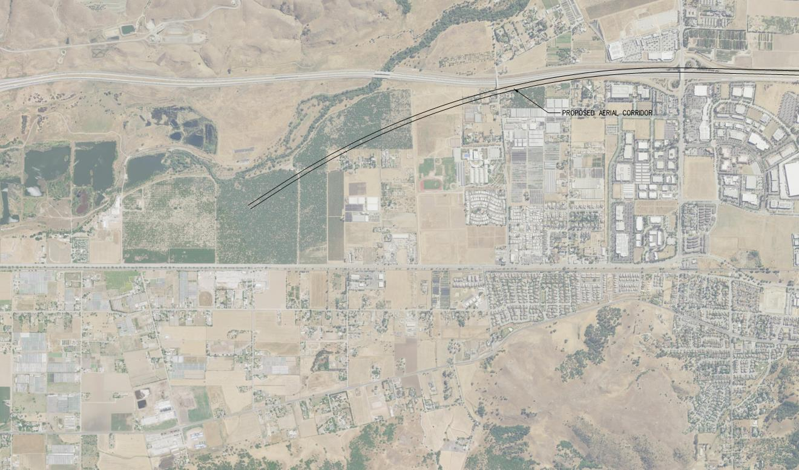
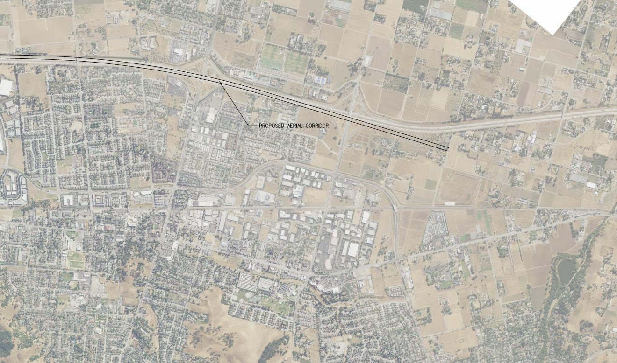
Viaduct in the median and east edge of US-101

Slide 16
Viaduct in the median and east edge of US-101
Design aspects
Located within the median and on the east side of US-101
Design speed up to 250 mph
Connects with CHSRA alignments north and south of Morgan Hill
CHALLENGES
Cannot continue in the median south of the City due to San Martin Airport
Significant length of complex structures, such as straddle bents
Not compatible with approved High Occupancy Toll (HOT) lanes project by Caltrans for the current US-101median.
Significant construction cost.
Notes:
This is a complex structure that would include saddle bent structures as well as structure within the median and along the east side of US-101.
The study utilized a design speed of 250 mph but it can be reduced to what is used by the CHSRA of 150 mph. This may reduce some of the complex structure.
This viaduct cannot continue within the median south of Morgan Hill due to impacts related to San Martin Airport.
The alternative is not compatible with a variant of the US-101 Expresslane Project.
This structure would be significantly more costly than the viaduct proposed by the CHSRA due to the complex structures.

Slide 17
Conclusions
Morgan Hill studied alternatives
Highway 101 Median Alternative:
Not compatible with Caltrans US-101 HOT Lane Project
Significant reduction in speed
Trench Alternative:
Complicated by waterproofing design requirement
May have additional construction & right-of-way impacts
East side Highway 101 Alternative:
Complex structures
May have additional construction & right-of-way impacts
Not compatible with US-101 HOT Lane Project
Notes:
The following conclusions were reached as part of the Morgan Hill study.
A viaduct alternative located within the median of US-101 is not practical for further study. While it is constructible, it is not compatible with a variant of the US-101 Expresslane Project. In addition, it is not compatible with the design speed necessary to maintain the CHSRA statutorily required travel times. In addition, the alternative will be more costly than the viaduct proposed by the CHSRA due to the need for complex structures.
A traditional trench structure would be advantageous, however, the CHSRA required structure will be more costly, have additional right-of-way and construction impacts. The cost of the CHSRA required structure is twice that of the viaduct option.
The east US-101 alternative is advantageous from a right-of-way standpoint. However, the complex structures associated with this option add significant costs. In addition, this is not compatible with a variant of the US-101 Expresslane Project due to the need to put bents into the median of the freeway.

Slide 18
Questions?

